Slide 1
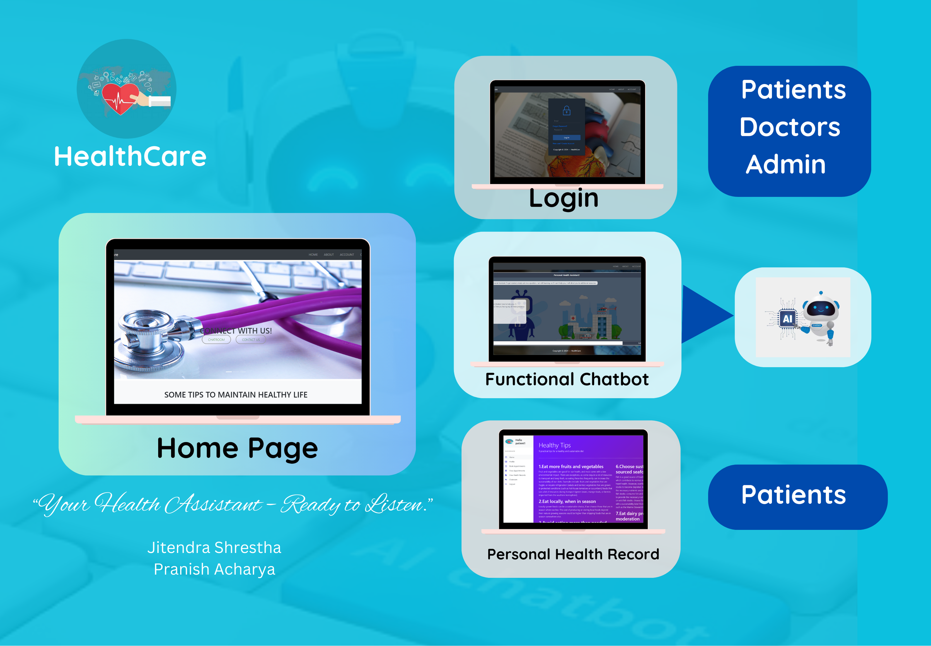

Slide 2


HEALTHCARE CHATBOT SYSTEM
TEAM MEMBERS:
JITENDRA SHRESTHA
PRANISH ACHARYA

Slide 3
INTRODUCTION
Service that provides to the user/client through interpreting natural language
Serves as healthcare assistant
Provides quick responses to common medical symptoms
Seamless User Experience

Slide 4
OBJECTIVES
To provide response on health queries
To diagnose disease based on symptoms provided based on yes/no statement
To provide way to maintain patient health record

Slide 5
FEATURES
Can predict disease based on symptoms provided
User can book appointment
User can view health records
Doctors can provide prescription to booked appointment
Admin can manage doctors

Slide 6
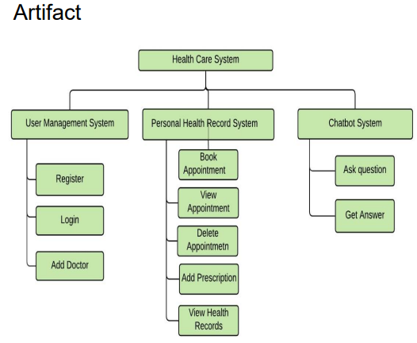
SYSTEM ARCHITECTURE

Slide 7
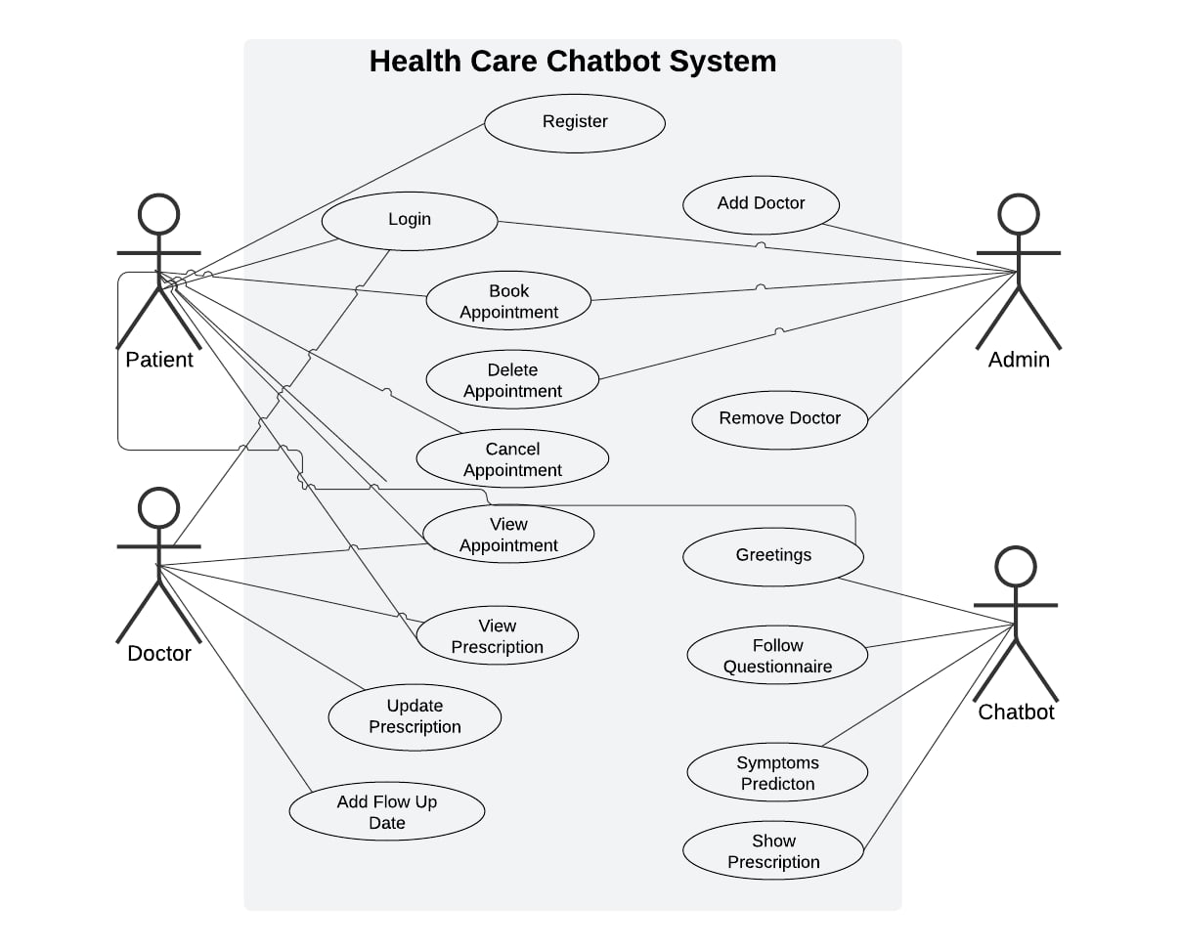
OVERALL USE CASE DIAGRAM

Slide 8
IMPLEMENTATION PLAN
Planning & Design
Development
Testing and Quality Assurance
Refinement and Finalization
Deployment and Project Closure
Initiation

Slide 9
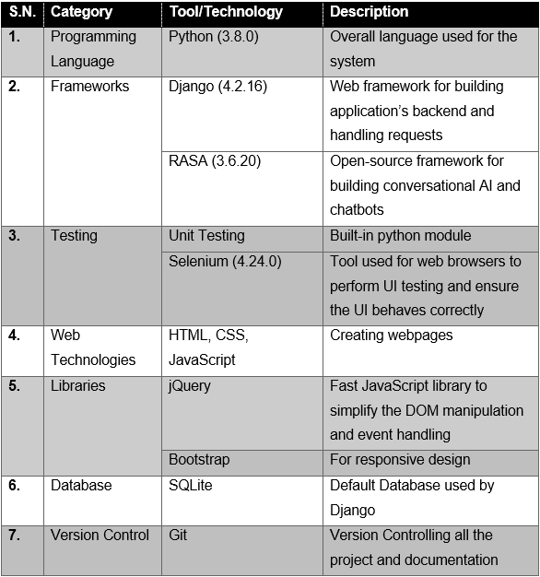
TOOLS & TECHNOLOGIES

Slide 10
ALTERNATIVE TOOLS
Chatbot Logic : Google Dialogflow, chatterbot
Frontend: React based on JavaScript
Backend: Node.js Framework
Database: MongoDB
Project Management: Asana

Slide 11
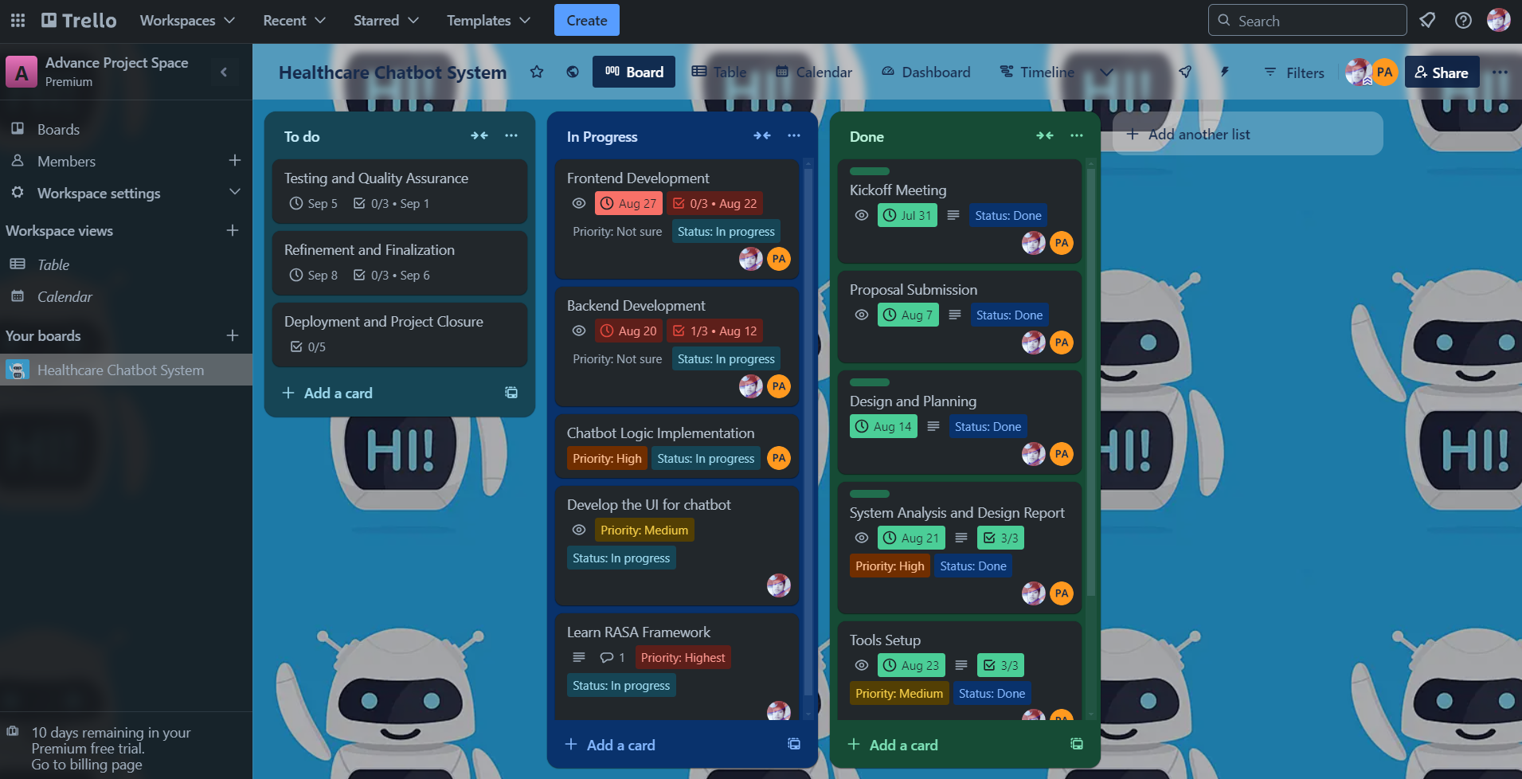
PROJECT MANAGEMENT

Slide 12
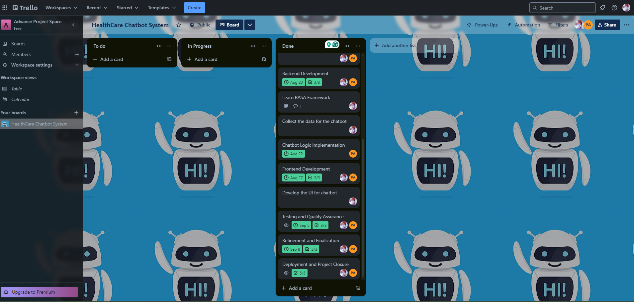
PROJECT MANAGEMENT- Contd.

Slide 13
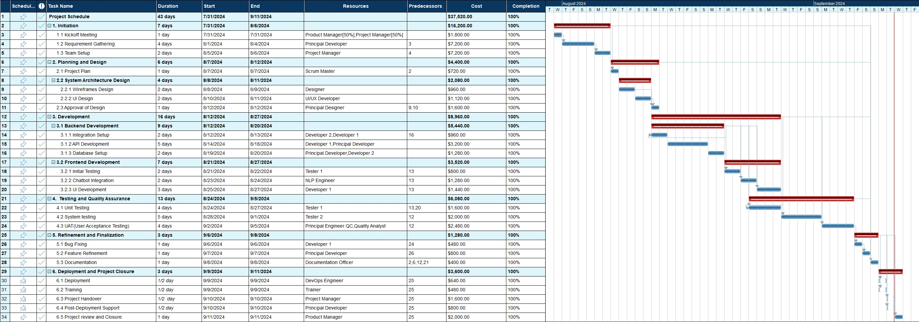
PROJECT SCHDEULE

Slide 14
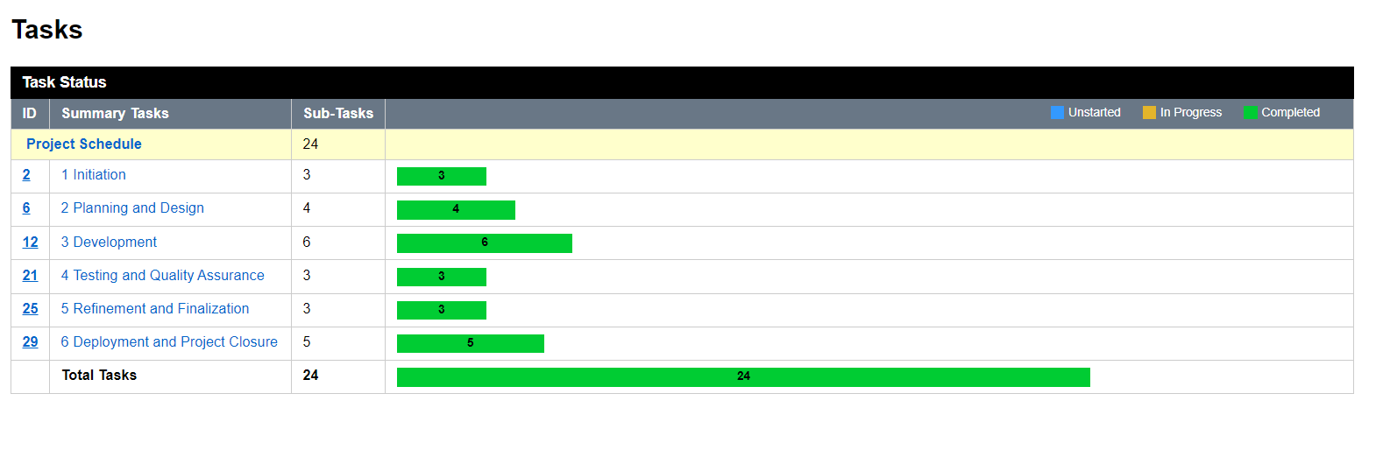
PROJECT PROGRESS

Slide 15
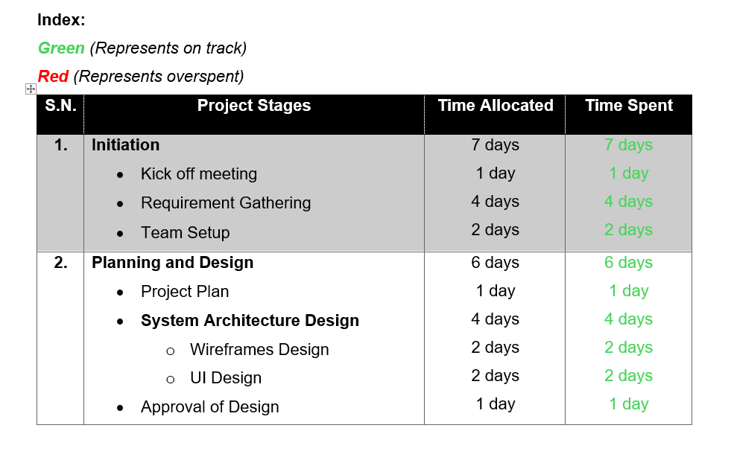
TIMELINE COMPARISON

Slide 16
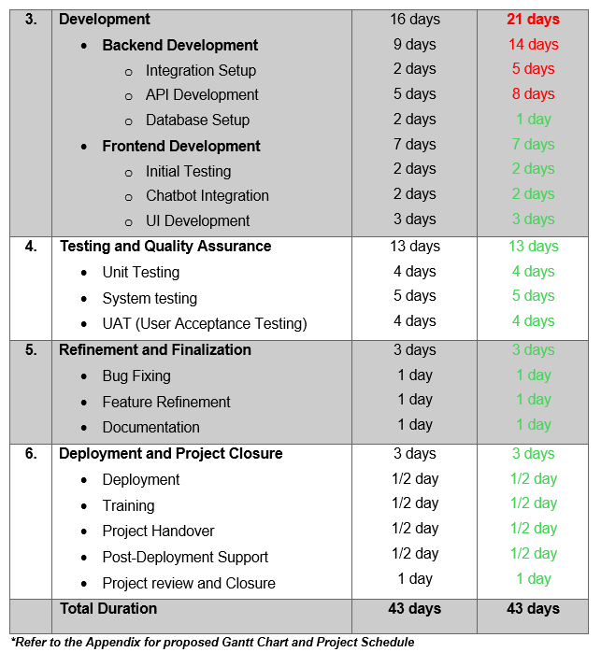
TIMELINE COMPARISON- Contd.

Slide 17
REASON FOR BEHIND THE SCHEDULE
Integration Setup
API Development

Slide 18
PROJECT TIMELINE

Slide 19
TEAM CONTRIBUTION
Team Member | Contribution
Jitendra Shrestha | Database Management UI Design and Development Frontend Integration Integration with Django Unit Testing and UI Testing Documentation
Pranish Acharya | Chatbot Logic Implementation using NLP Data Classification Train Chatbot Dialogue Management API Development for chatbot Documentation

Slide 20
Some Screenshots of System

Slide 21
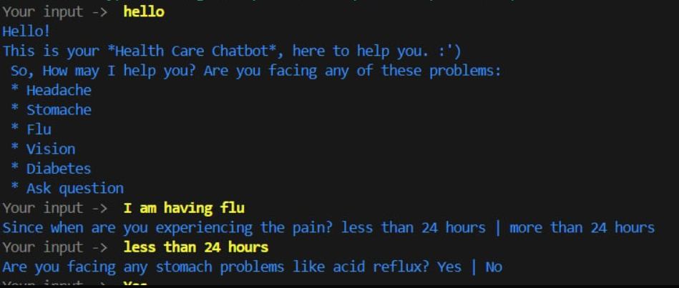

Slide 22
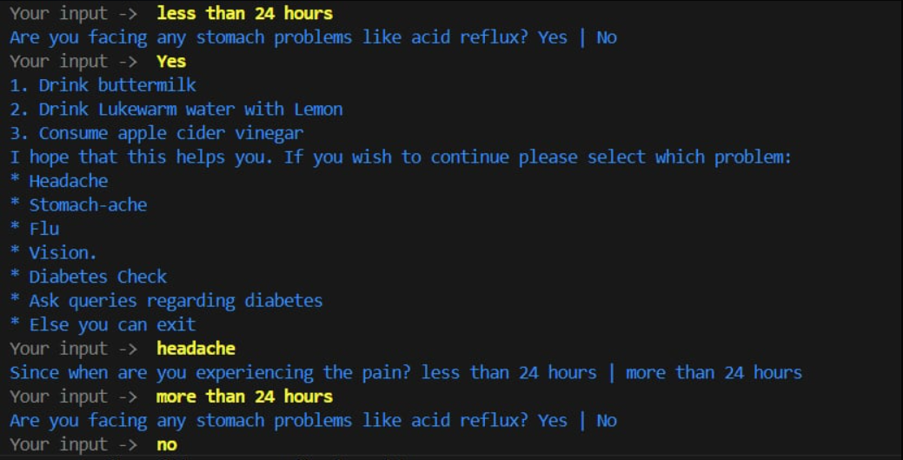

Slide 23
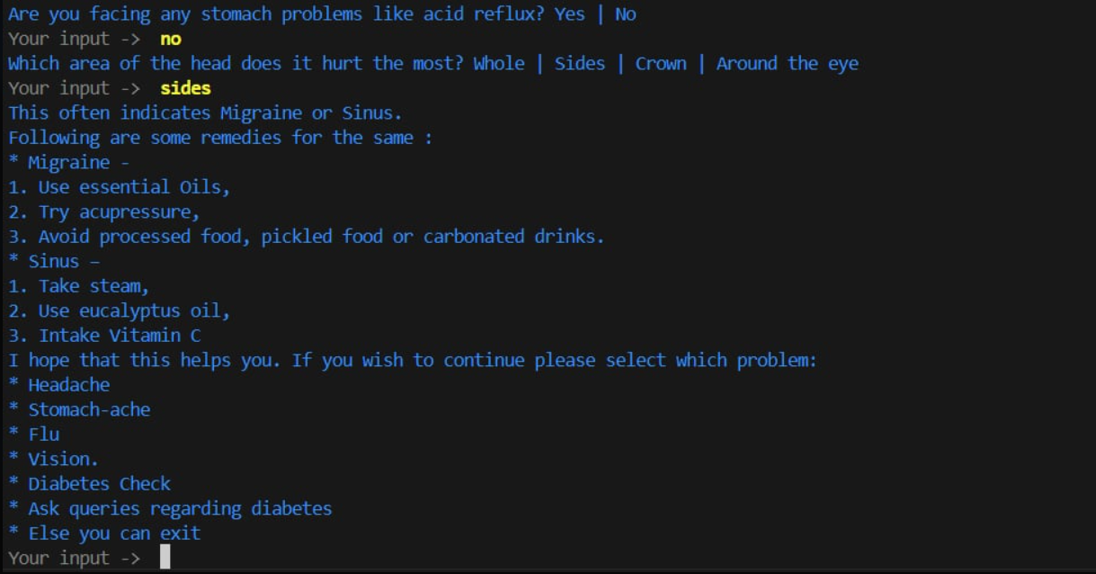

Slide 24
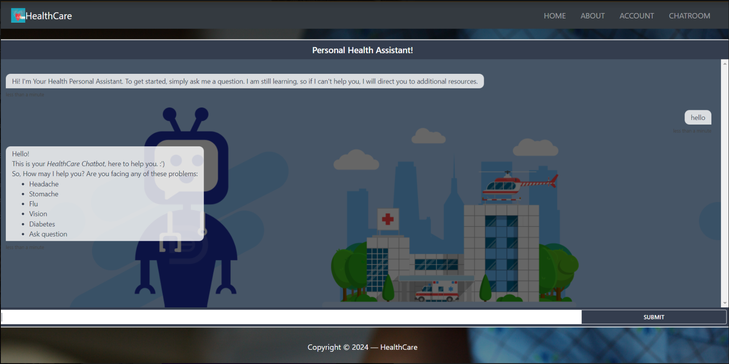

Slide 25
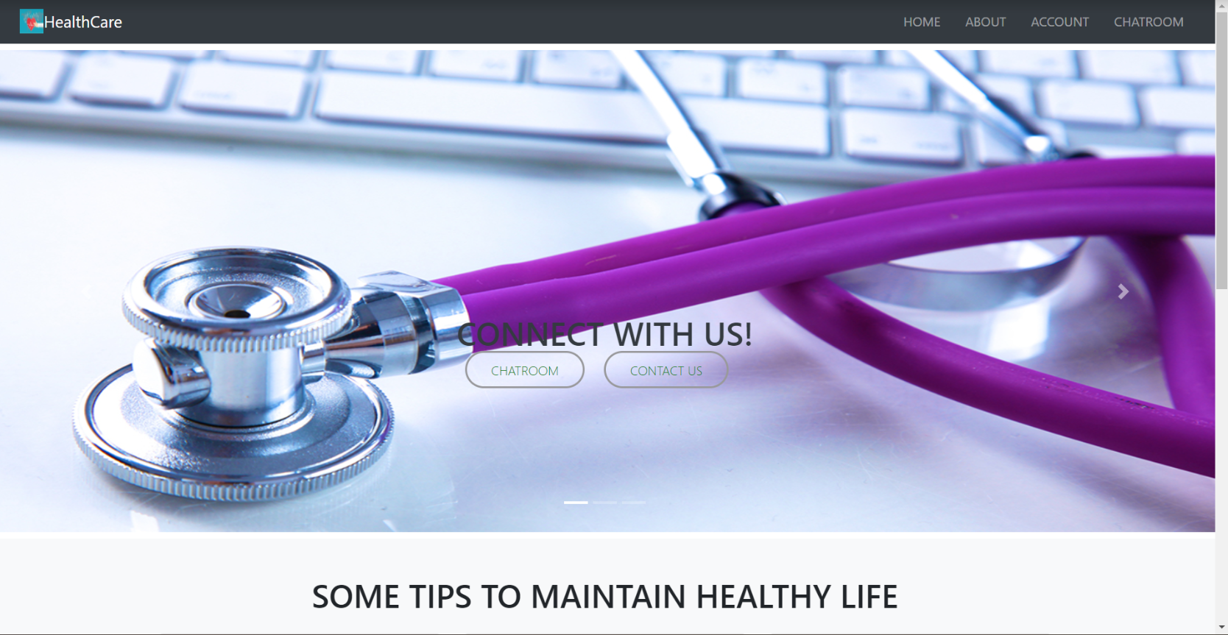

Slide 26
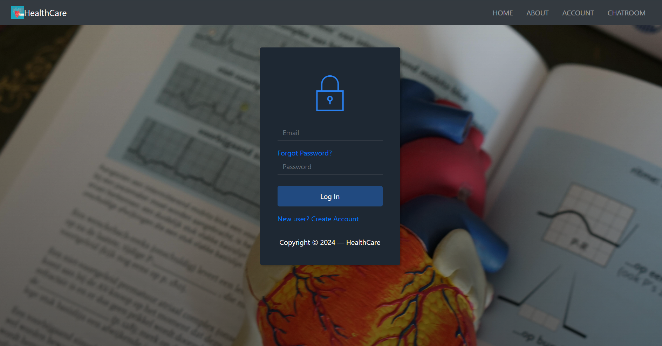

Slide 27


